Slide 1

PRESENTATION OVERVIEW
Team
YUE

Slide 2
The Youth Unemployment Challenge
Addressing South Africa's pressing socio-economic issue
Youth unemployment in South Africa is a critical issue, requiring effective forecasting for policy and planning solutions.

Slide 3
Introduction to Forecasting
Understanding Youth Unemployment for Effective Planning
Accurate forecasting is vital for addressing socio-economic challenges, enabling policymakers to implement targeted interventions for youth unemployment.

Slide 4
Project Objectives
01
Preparation
02
Analysis
Clean and organize data
Explore data patterns
03
Development
04
Evaluation
Create multiple models
Assess model performance
05
Forecasting
Predict unemployment rates

Slide 5



Data and Methodology
Data Collection
Data Cleaning
Exploratory Analysis
Global sources used
Refining datasets
Identifying patterns

Slide 6
Data and Methodology
Overview of Modeling Techniques and Evaluation
Model Evaluation
Prediction Outcomes
Modeling Approaches
Performance metrics were utilized to assess model effectiveness and reliability.
Forecasts were generated to inform policy decisions on youth unemployment.
Various machine learning models were applied for accurate forecasting.

Slide 7
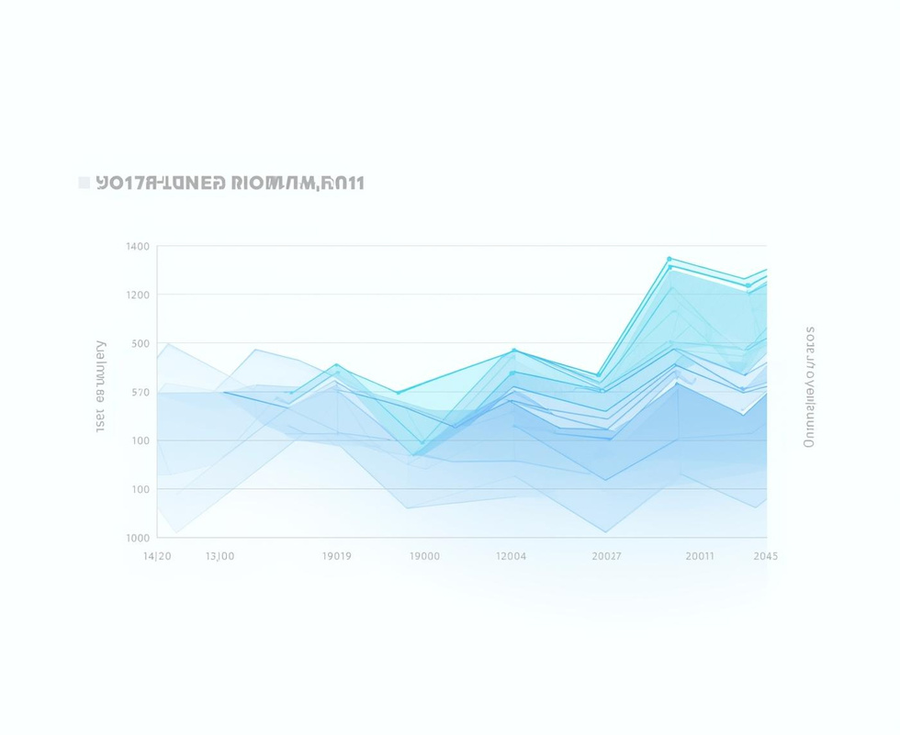
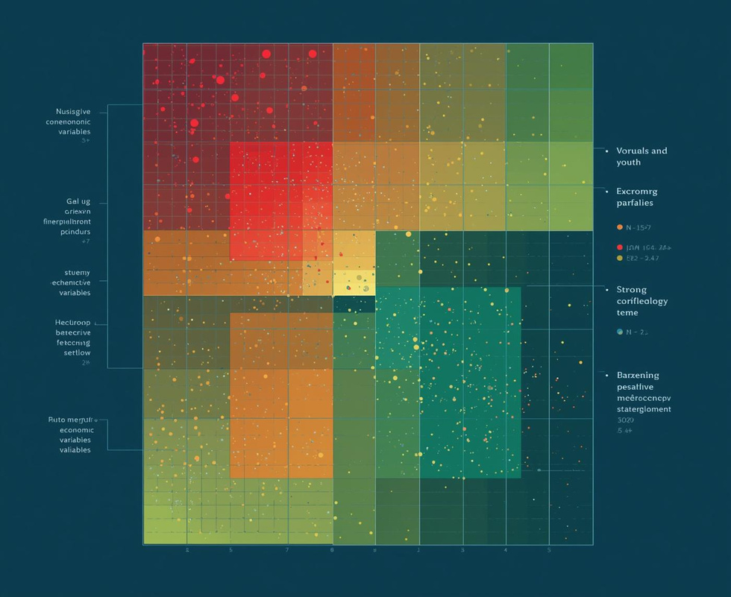
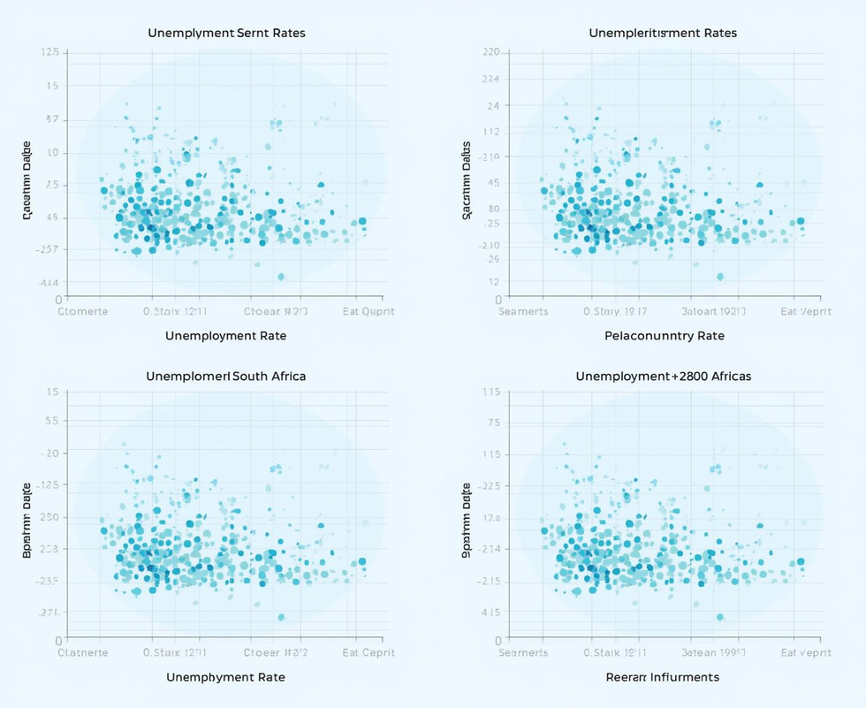
Key Patterns and Correlations
Unemployment Trends
Correlation Insights
Comparative Analysis
Youth rates over time
Key variable relationships
Insights from peers

Slide 8
Model Development
Overview of Machine Learning Models Applied
Random Forest
Linear Regression
ElasticNet
Ensemble method combining multiple decision trees for improved accuracy.
Baseline model predicting outcomes using a linear approach.
Combines L1 and L2 regularization for optimal feature selection.

Slide 9
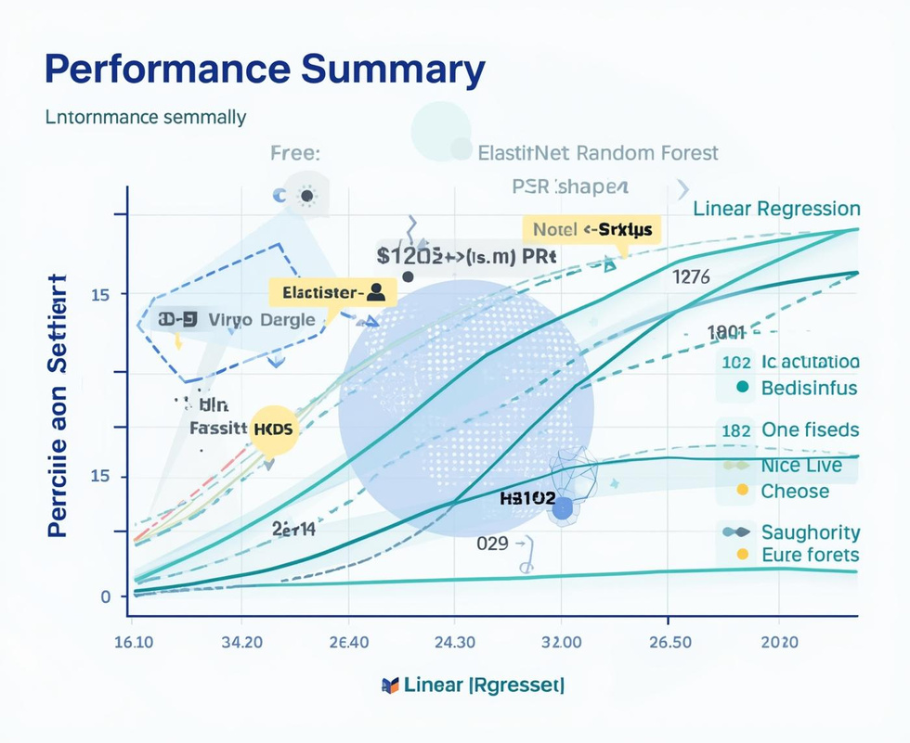
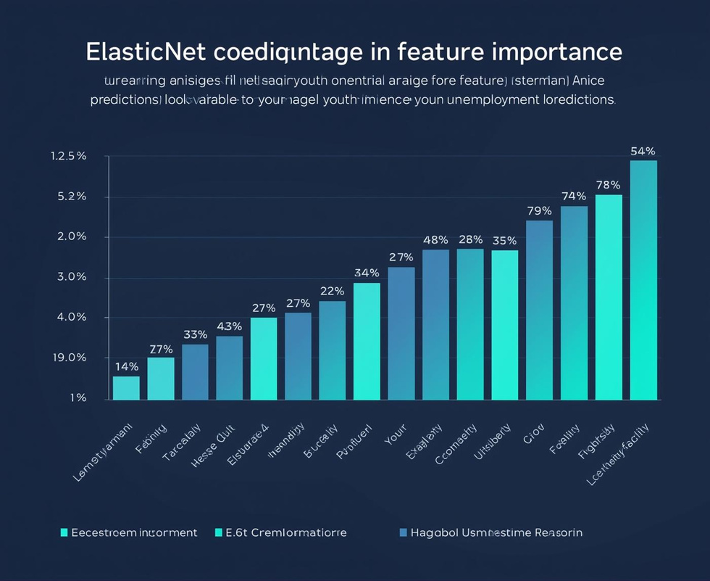
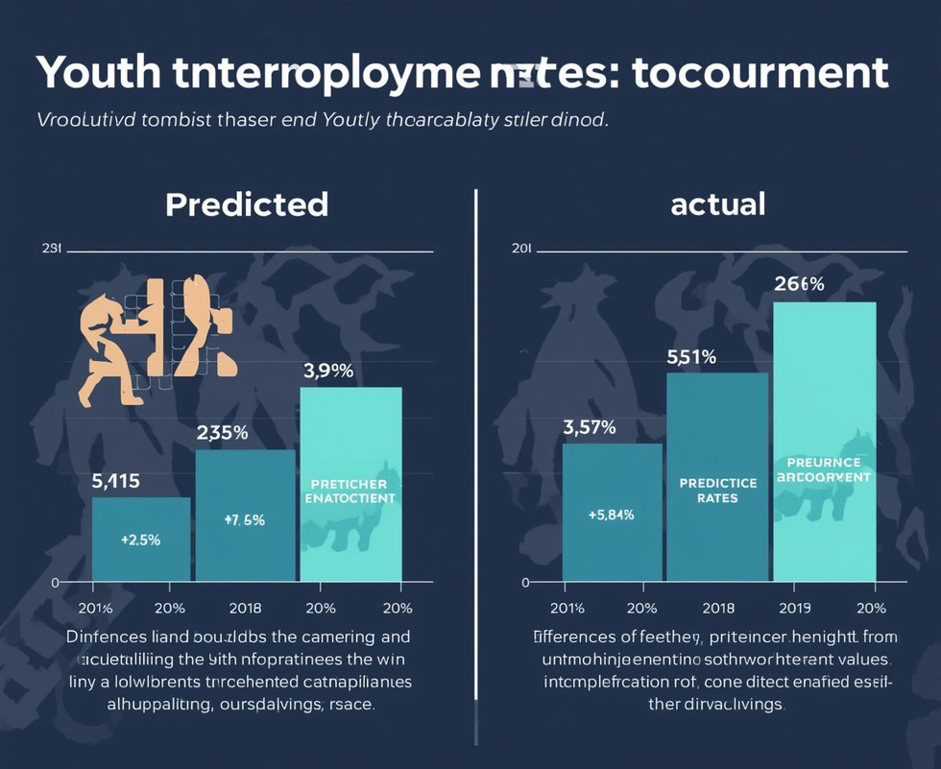
Model Results and Insights
ElasticNet Performance
Feature Importance
Prediction Accuracy
Best model outcome
Key predictors identified
Close to actual values

Slide 10

Youth Unemployment Prediction
Forecast
Insights on South Africa's youth unemployment rates.

Slide 11
Discussion & Findings
Key Insights and Model Evaluation
Identified Trends
Model Robustness
Significant patterns in youth unemployment reveal cyclical economic impacts.
Selected algorithms demonstrate strong predictive capabilities with minimal overfitting.

Slide 12
Conclusion & Future Work
Recap achievements and suggest improvements
Accurate Forecasting
Model Insights
Future Enhancements
Developed models that effectively predicted youth unemployment trends.
Gained valuable understanding of influencing factors on predictions.
Will incorporate advanced models and additional data features for accuracy.

Slide 13
Any Questions?
Khensani Emmelda Chabalala
Tshifhiwa Samuel Mphephu
Lindelani Prince Maseko
230072321
222012773
231096429

